Slide 1


Economic Impact of Major Sporting Events
Michael Legg
Kendall Marquard
Salvador Neves
Luis Ramirez
Ognjen Strbanovic
Notes:
Image Sources (in order - top to bottom, left to right):
https://www.google.com/search?q=2012+olympics&sxsrf=ALeKk01ldHFtRRGcWQDkKppi1UolFEIDYg:1584666710013&source=lnms&tbm=isch&sa=X&ved=2ahUKEwiWqtnC76foAhUvmHIEHTcfBs8Q_AUoAXoECBkQAw&biw=1440&bih=700#imgrc=VPnkWCAm5NF1VM
https://www.google.com/search?q=2010+world+cup&tbm=isch&ved=2ahUKEwjAgeDD76foAhWEAN8KHUZ4ByoQ2-cCegQIABAA&oq=2010+wo&gs_l=img.1.0.0l10.71251.72534..73651...0.0..0.85.538.7......0....1..gws-wiz-img.......0i67j0i131i67.hvr_zAtwoCU&ei=WBh0XsD1DISB_AbG8J3QAg&bih=700&biw=1440#imgrc=FKKUd4JDdWx2-M

Slide 2
Motivation & Summary
Core Message/Hypothesis:
The investments (mostly by means of infrastructure spending) made by London in the 2012 Summer Olympics and South Africa in the 2010 FIFA World Cup had a short-run positive economic impact.
The “ask”:
What is the short-run economic impact of the two biggest sporting events in the world on the host city/country?
We asked this question for two reasons:
The topic of sports was of interest to us.
There is not an obvious/clear answer to the question above.

Slide 3
Motivation & Summary (cont)
We were not 100% able to answer this question to our satisfaction because:
In hindsight, the scope of the question that we asked was a bit too large.
The time constraint and lack of in-person meetings due to COVID-19 limited the depth of our analysis.
If one were to research this topic extensively, one would find that there is quite a debate going on about our very “ask”.
A brief summary of each of our findings:
Infrastructure certainly increased a significant amount in the buildup to these worldwide events, as one might expect. This is an increase in government spending, and should result in a jolt to the domestic/local economy.
Quarterly economic growth showed a steep increase when the Olympics were hosted in London.
The data showed a steady increase of passengers coming into UK and South Africa during the two major sporting events.

Slide 4
Questions & Data
To elaborate on the question that we asked: we purposely looked at two different countries for comparison purposes - that is, one that is developed (GB) and another that is considered developing (SA); we also had it in mind to choose events that were only two years apart, to control for the global economy’s performance at the times studied.
Kinds of data that we needed to answer this question:
We used both API/JSON data, as well as downloaded CSVs.

Slide 5
Data Sources
How we found this data:
Firstly, we looked at construction statistics for GB and SA - after extensive Googling, we found this on government sites such as the “Office for National Statistics” and “THE WORLD BANK” websites, respectively.
The “theglobaleconomy.com” website had GDP data for the countries of GB and SA.
“data.fixer.io/api” - exchange rate information for GB & SA
“api.worldbank.org” - “THE WORLD BANK” API
caa.co.uk/Data-and-analysis/UK-aviation-market/Airports/Datasets/ - Arriving flight information for major London airports

Slide 6
Data Cleanup & Exploration
Exploration and cleanup process description: Just searching for the data took up a very large amount of the time allocated to this project. Cleaning up the data was fairly easy, using techniques that we learned in-class.
Some insights that we got while exploring the data that we didn’t anticipate were: that there were quite a few confounding variables present.
For instance, London is a tourist attraction in general, and so the uptick in incoming flights for the Olympics wasn’t so dramatic compared to the years surrounding it.
Another instance: the overall health of the global economy was quite unique at the time, as it was recovering from the Great Recession; so this had a major impact on GDP, exchange rates, and arriving flights.
London had a well-developed infrastructure of stadiums already in place; South Africa did not.
Some problems that arose after exploring the data included: finding data sources that were free, relevant, and easy to work with; also, getting conclusive results so that we could test our hypothesis.
Getting conclusive results about our hypothesis from the data.
We resolved them by: group discussion and consultation (only over Zoom). Individually: we used the drop method to get rid of undesired columns and rows, changed the type of the data to int or float.
Should we walkthrough one of the notebooks quickly for this? Might be more effective.

Slide 7
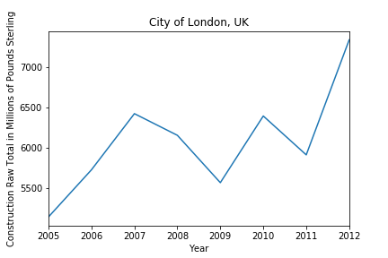
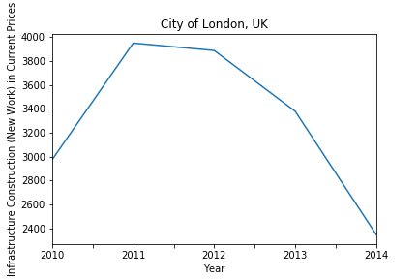
Data Analysis - Infrastructure 👷‍♂️🚧
Some interesting figures that were developed during analysis were the two below plots, and the third in the next slide.
The first plot shows an upward trend that peaks during Olympics time. Unfortunately, there was no data past 2012.
The second plot shows infrastructure in London rising then peaking at the year of the Olympics; then, it falls down significantly.

Slide 8
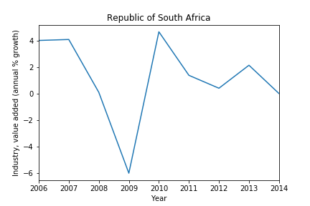
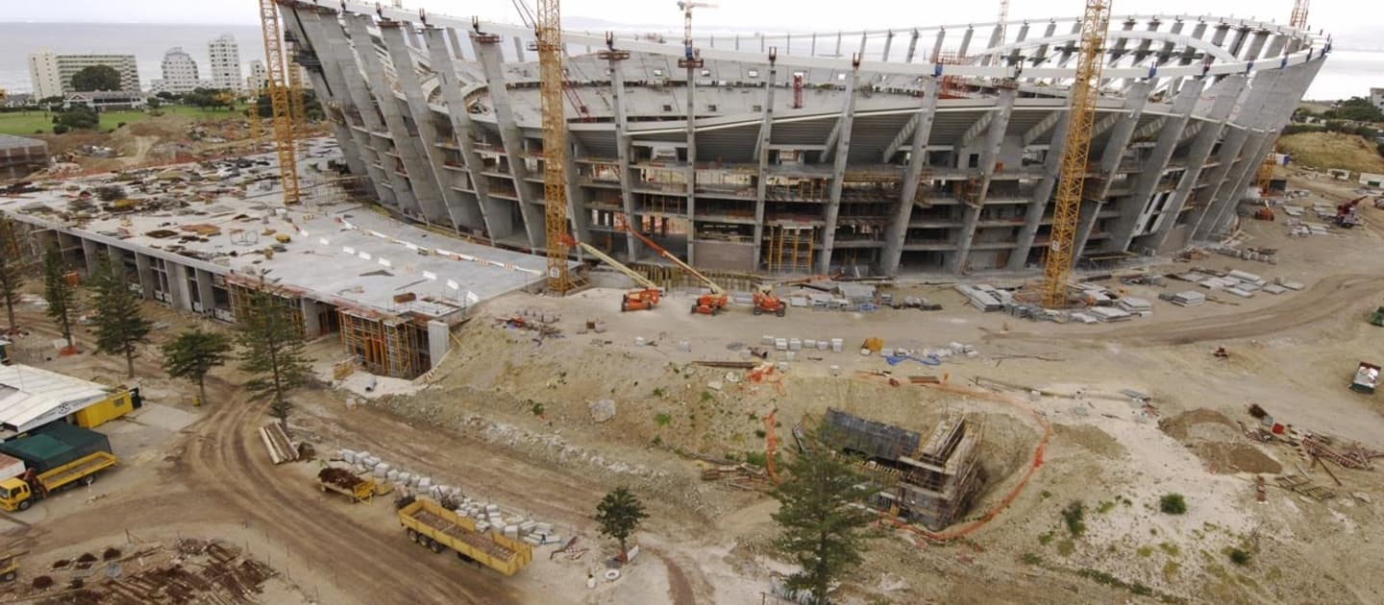
Data Analysis - Infrastructure (cont)
The mean is 1.229% during this period. In 2010, the annual % growth was 4.706, which was also the max.
This is a significant difference between the mean and peak industry during this eight-year time period.
Notes:
Image source: https://www.fifa.com/worldcup/news/2010-stadium-creates-thousands-jobs-988784

Slide 9
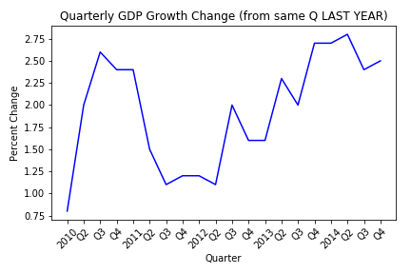
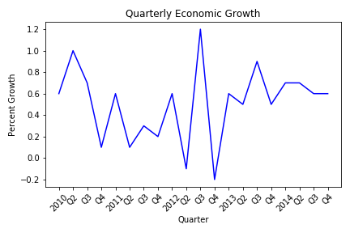
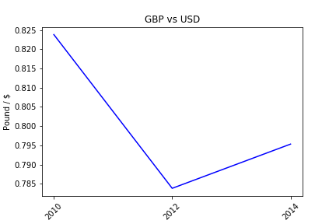
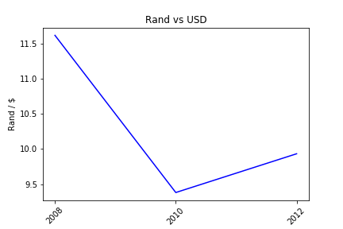
Data Analysis - Quarterly GDP & XR 📈
There was a short-term “spike” in economic growth during Q3 of 2012.
Also, the foreign currency very much seems to strengthen against the dollar.

Slide 10
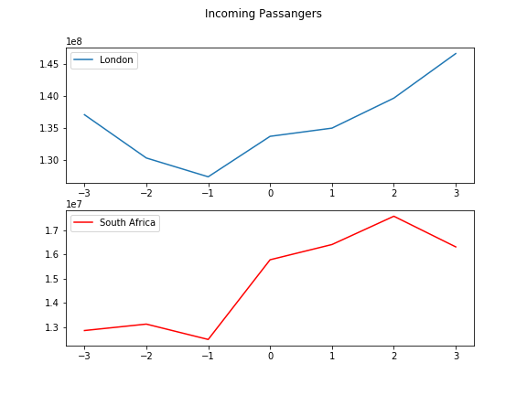
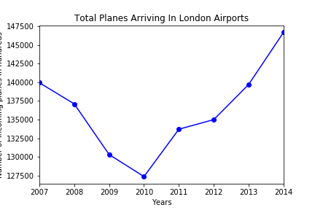
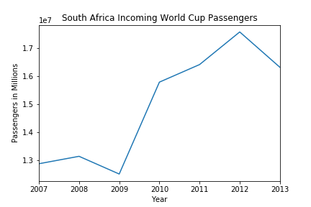
Data Analysis - Visitors 🛬
Our goal was to better understand the potential rise or decline in tourism before, during, and after a country hosts an major international athletic competition.
We wanted to take into account how developed a country was at the time of the event to measure the impact that the event can have on tourism in developed vs. developing countries.
Our findings support a rise in tourism post-event for both countries (regardless of level of development).

Slide 11
Discussion
We (mostly) found what we expected.
There certainly was a short-term economic boost...
Despite an overall poor year, Q3 in 2012 showed a peak in activity for the U.K.
The strengthening of the currency vs. USD around the time of the event.
There was a rise in tourism post international events for both of the countries that we measured.
What is less obvious are the long-term economic implications...
Spending, debt, unemployment, etc.
What we did not expect to find:
Infrastructure spending before the events were less conclusive than expected.
Inferences:
Large sporting events create a temporary boost in activity in certain areas of the economy such as the service and construction industries.
Long-term effects remain unclear.
The limitations of our findings are that we used a small sample size of only two nations. We also compared different types of international athletic events, which can result in several confounding variables.

Slide 12
Post Mortem
We dealt with them by:
Trying out multiple datasets and types of data.
Analyzing many different economic indicators.
The additional questions that may have come up, but didn’t have time to answer, were:
Was the effort put into hosting these events worthwhile?
To what extent are developing economies affected compared to developed economies? Short-term vs. long-term effects?
Next, we would research the following if we had two more weeks:
We would have collected more economic indicators to paint a bigger and better picture of economic impact.
We would have looked for more identical (“twin”) datasets for comparison across countries.

Slide 13
Questions?
🤔 ✋
We are happy to answer any and all

Slide 14
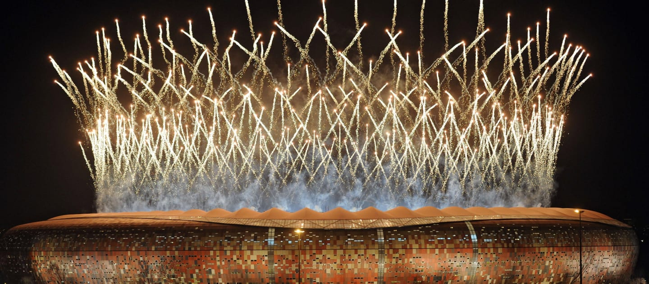
Thank you!
Notes:
Image source: https://www.fifa.com/worldcup/news/south-africa-2010-teams-stories-1272292

